Slide 1
Capstone Project:
Analytical CRM Development for a Bank

Slide 2

Agenda
Problem Statement
Data Description
Objective Key Metrics and Visualizations
Subjective Question for Insights

Slide 3
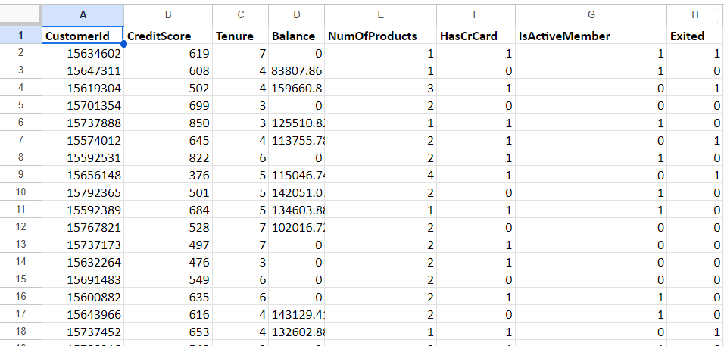
Problem Statement
You are an analytical CRM (Customer Relationship Management) specialist hired by a bank to extract meaningful insights from various customer-related datasets. The bank aims to reduce customer churn, improve service delivery, and enhance customer satisfaction. They have provided you with datasets including customer demographics, transaction details, customer exit information, and active customer profiles.

Slide 4
The image above displays details about Bank Customer data, including:
RowNumber: The row number in the dataset, likely used for reference or indexing.
CustomerId: A unique identifier for each customer.
CreditScore: A numerical representation of the customer's creditworthiness.
Credit score:
Excellent: 800–850
Very Good: 740–799
Good: 670–739
Fair: 580–669
Poor: 300–579
GeographyID: A numerical identifier that likely corresponds to a geographical location, such as a country or region.
GenderID: A numerical identifier for the customer's gender, where for example, '1' could represent male and '2' could represent female.

Slide 5
The image above displays details about Bank Customer data, including:
Age: The age of the customer.
Tenure: The number of years the customer has been with the bank.
Balance: Current balance in the customer's account.
NumOfProducts: refers to the number of products that a customer has purchased through the bank.
HasCrCard: denotes whether or not a customer has a credit card. This column is also relevant, since people with a credit card are less likely to leave the bank.
1 represents credit card holder
0 represents non credit card holder

Slide 6
The image above displays details about Bank Customer data, including:
IsActiveMember: active customers are less likely to leave the bank (as per the criteria defined by the bank for identifying the activeness).
1 represents Active Member
0 represents Inactive Member
Estimated Salary: as with balance, people with lower salaries are more likely to leave the bank compared to those with higher salaries.
Exited: whether or not the customer left the bank.
0 represents Retain
1 represents Exit
Bank DOJ: date when the Customer associated/joined with the bank.

Slide 7
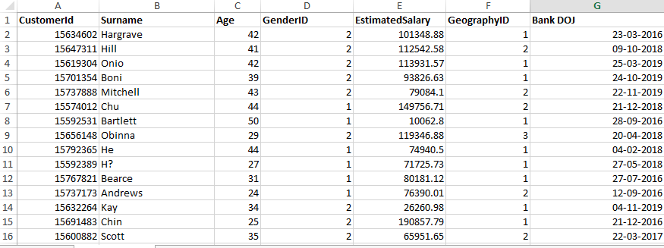
Problem Statement
You are an analytical CRM (Customer Relationship Management) specialist hired by a bank to extract meaningful insights from various customer-related datasets. The bank aims to reduce customer churn, improve service delivery, and enhance customer satisfaction. They have provided you with datasets including customer demographics, transaction details, customer exit information, and active customer profiles.

Slide 8
The image above displays details about Bank Customer data, including:
Customer Id : A unique identifier for each customer.
Surname: Last name of the customer
Age: Age of the customer
Gender ID: A numerical identifier for the customer's gender, where for example, '1' could represent male and '2' could represent female.
Estimated Salary: Estimated Salary of the customer
Geography ID:A numerical identifier for the customer's geography , where for example, '1' could represent France , '2' could represent Spain and ‘3’ could represent Germany.
Bank DOJ: Joining date of the customer

Slide 9

Use this Link for copying and then manipulating the dataset.

Slide 10

Tasks
…Tasks in order to come up with suggestions

Slide 11
Introduction :
In the competitive world of banking, understanding why customers leave and how to retain them is crucial for sustaining growth and profitability. To address these challenges, we embarked on an in-depth analysis of our bank's customer data, aiming to uncover insights that could inform our strategies for improving customer retention and acquisition. Our journey involved answering a series of key questions using data analysis and visualization techniques. Here’s the story of our findings.

Slide 12
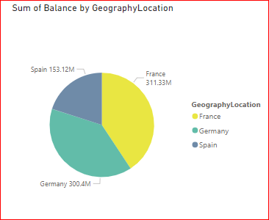
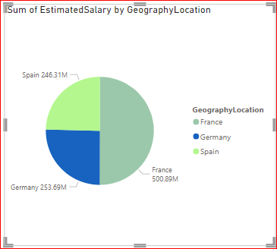
Objective Questions
What is the distribution of account balance across different regions?
In order to answer the above question we can simply create a pie chart on the basis of account balance as there are only three location present in our dataset and dataset.

Slide 13
Objective Questions
Identify the top 5 customers with the highest Estimated Salary in the last quarter of the year. (SQL)
As we are provided with the data of customerInfo table , where Bank DOJ column is in text format , we tried it to change to DATETIME but it’s not getting imported in SQL due to some reason. To fix that , we have created another column named “DateOfJoining” with DATE format in the customerInfo table and set the values from the existing column Bank DOJ .
Created new column with date format
alter table customerinfo
add DateOfJoining DATE
Copied values from the existing Bank DOJ column to the newly created DateOfJoining Column
Update customerInfo
Set DateOfJoining = str_to_date(`Bank DOJ`, ‘%d’-‘%m’-‘%Y’

Slide 14
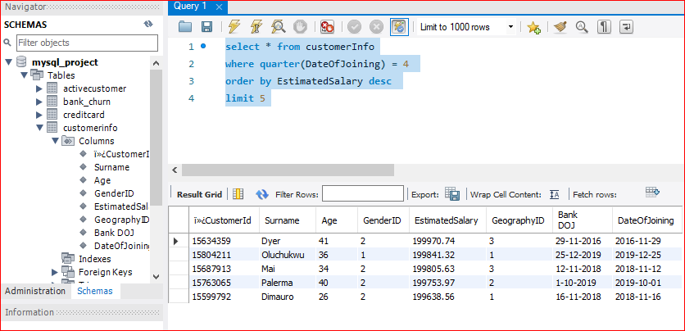
Objective Questions
Conclusion :
select * from customerInfo
where quarter(DateOfJoining) = 4
order by EstimatedSalary desc
limit 5

Slide 15
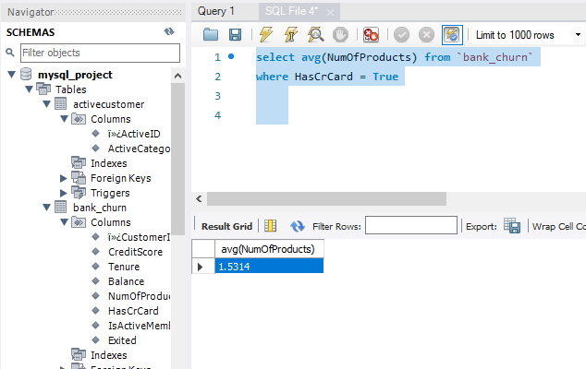
Objective Questions
Calculate the average number of products used by customers who have a credit card. (SQL)
select avg(NumOfProducts) from `bank_churn`
where HasCrCard = True
The average number of products used by customers who have a credit card is
1.5315

Slide 16
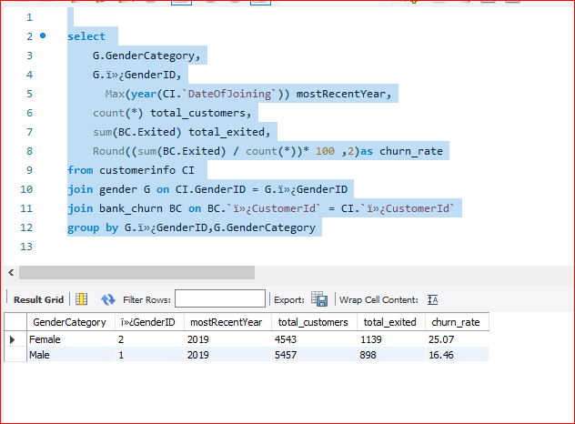
Objective Questions
Determine the churn rate by gender for the most recent year in the dataset.
Churn is basically the sum of total exited customer by total number of customer and then we can group it on the basis of the gender .
Identify the churn rate by Gender :
select
G.GenderCategory,
G.ï»¿GenderID,
Max(year(CI.`DateOfJoining`)) mostRecentYear,
count(*) total_customers,
sum(BC.Exited) total_exited,
Round((sum(BC.Exited) / count(*))* 100 ,2)as churn_rate
from customerinfo CI
join gender G on CI.GenderID = G.ï»¿GenderID
join bank_churn BC on BC.`ï»¿CustomerId` = CI.`ï»¿CustomerId`
group by G.ï»¿GenderID,G.GenderCategory
Churn rate for the most recent year on the basis of genders are
Male : 16.46
Female : 25.07

Slide 17
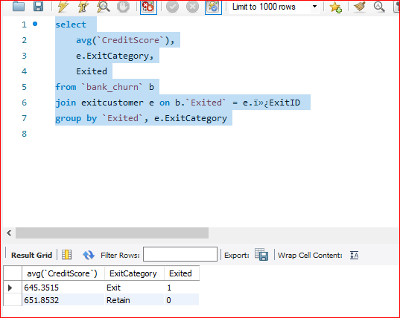
Objective Questions
Compare the average credit score of customers who have exited and those who remain. (SQL)
select
avg(`CreditScore`),
e.ExitCategory,
Exited
from `bank_churn` b
join exitcustomer e on b.`Exited` = e.ï»¿ExitID
group by `Exited`, e.ExitCategory

Slide 18
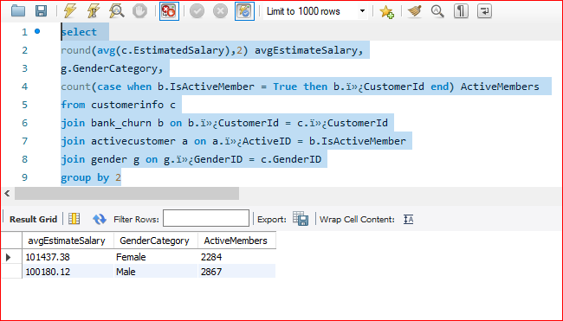
Objective Questions
Which gender has a higher average estimated salary, and how does it relate to the number of active accounts? (SQL)
select
round(avg(c.EstimatedSalary),2) avgEstimateSalary,
g.GenderCategory,
count(case when b.IsActiveMember = True then b.ï»¿CustomerId end) ActiveMembers
from customerinfo c
join bank_churn b on b.ï»¿CustomerId = c.ï»¿CustomerId
join activecustomer a on a.ï»¿ActiveID = b.IsActiveMember
join gender g on g.ï»¿GenderID = c.GenderID
group by 2
As we can see , Females are having the higher estimated salary but the number of active Members of male are greater than of females

Slide 19
Objective Questions
Segment the customers based on their credit score and identify the segment with the highest exit rate. (SQL)
Approach : We have divided the segment into five categories initially which are as below
Credit score:
Excellent: 800–850
Very Good: 740–799
Good: 670–739
Fair: 580–669
Poor: 300–579
Exit Rate : Number of customers who have exited divided total customers and in order to calculate the rate we can multiple it by 100

Slide 20
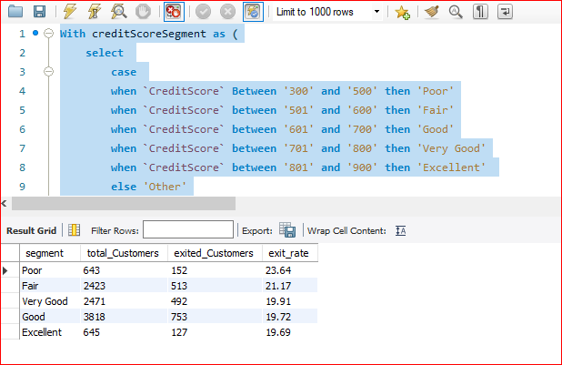
Objective Questions
Conclusion:

Slide 21
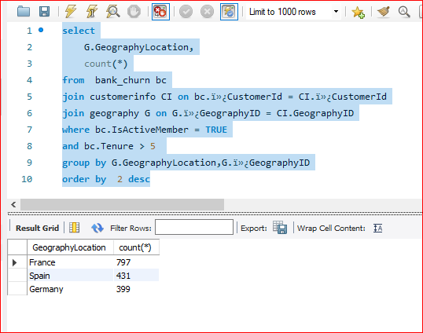
Objective Questions (Cont..)
Find out which geographic region has the highest number of active customers with a tenure greater than 5 years. (SQL)
select
G.GeographyLocation,
count(*)
from bank_churn bc
join customerinfo CI on bc.ï»¿CustomerId = CI.ï»¿CustomerId
join geography G on G.ï»¿GeographyID = CI.GeographyID
where bc.IsActiveMember = TRUE
and bc.Tenure > 5
group by G.GeographyLocation,G.ï»¿GeographyID
order by 2 desc
As we can see France has the highest number of active customer with a tenure greater than 5 years.

Slide 22
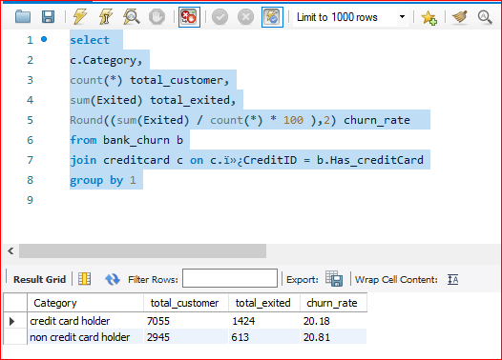
Objective Questions (Cont..)
What is the impact of having a credit card on customer churn, based on the available data?
Approach : In order to determine the impact of having a credit card on customer churn, we have initially found the churn rate of customers who has credit card.
select
c.Category,
count(*) total_customer,
sum(Exited) total_exited,
Round((sum(Exited) / count(*) * 100 ),2) churn_rate
from bank_churn b
join creditcard c on c.ï»¿CreditID = b.Has_creditCard
group by 1
As per our analysis the churn rate of customers with credit card is slightly less than the customers who don’t have a credit card. This suggests that having a credit card might have a slight positive impact on customer retention.

Slide 23
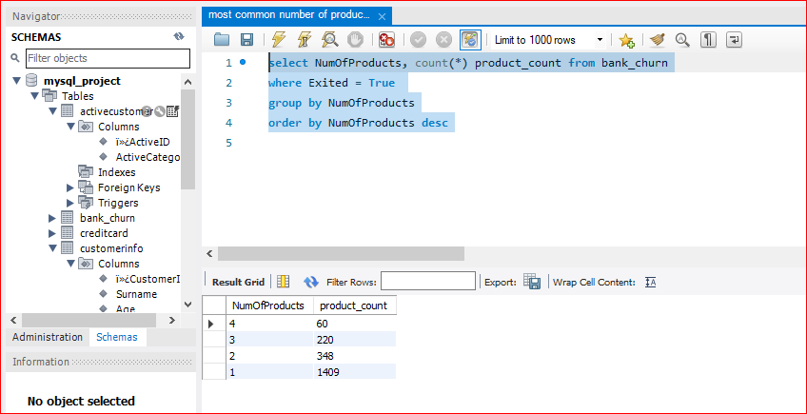
Objective Questions (Cont..)
For customers who have exited, what is the most common number of products they have used?
select NumOfProducts, count(*) product_count from bank_churn
where Exited = True
group by NumOfProducts
order by NumOfProducts desc

Slide 24
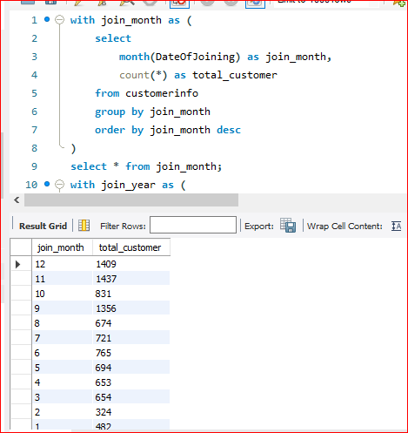
Objective Questions (Cont..)
Examine the trend of customer joining over time and identify any seasonal patterns (yearly or monthly). Prepare the data through SQL and then visualize it.
Visualization (Month wise) :

Slide 25
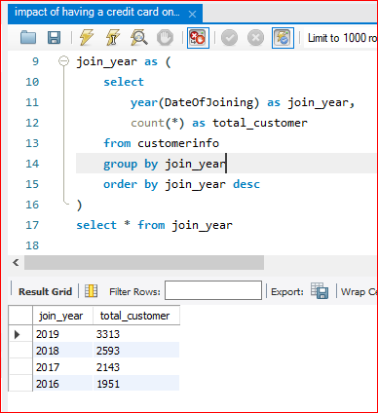
Objective Questions (Cont..)
Visualization (Year wise):

Slide 26
Objective Questions (Cont..)
Analyze the relationship between the number of products and the account balance for customers who have exited.
To analyze the relationship between the number of products and the account balance for customers who have exited , we will be using the NumOfProducts and EstimatedSalary from the data we are provided and group it by the NumOfProducts
select
BC.NumOfProducts ,
round(sum(BC.Balance) ,2) as SumOfAccountBalance
from customerinfo CI
join bank_churn BC on BC.ï»¿CustomerId = CI.ï»¿CustomerId
where BC.Exited = TRUE
group by BC.NumOfProducts

Slide 27
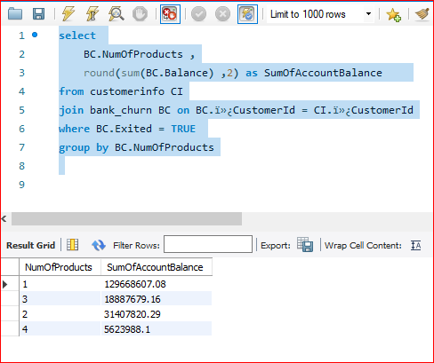
Objective Questions (Cont..)

Slide 28
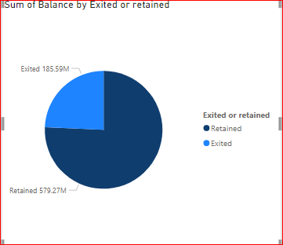
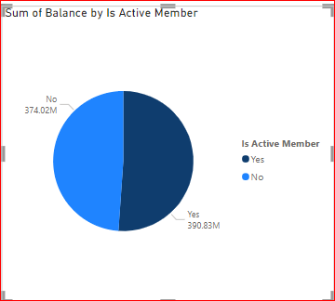
Objective Questions (Cont..)
Identify any potential outliers in terms of balance among customers who have remained with the bank.
If we look at the sum of the bank balance of both the customers who remained with the bank and who have exited. We can see that those customers who remained with the bank account for 75% of the total bank balance.

Slide 29
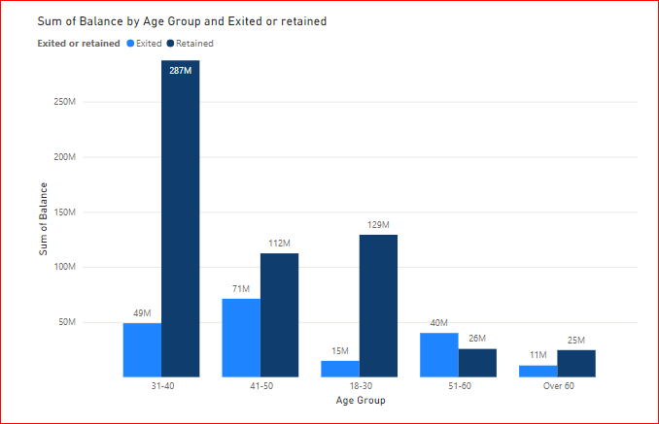
Objective Questions (Cont..)
If we look at the bank balance of the customers who are retained by the company and those who exited , we can clearly see the one’s who are retained are having higher bank balance than those who exited except in the age-group of 51-60 where the Exited customer had higher bank balance.

Slide 30
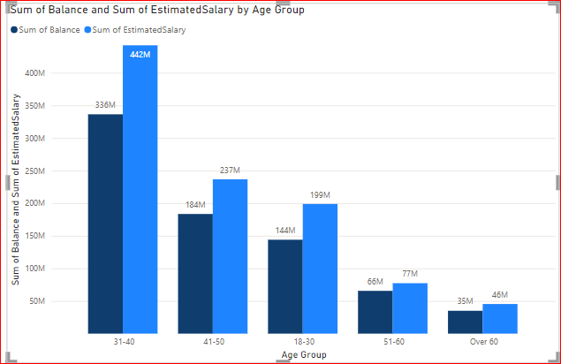
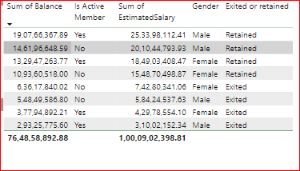
Objective Questions (Cont..)

Slide 31
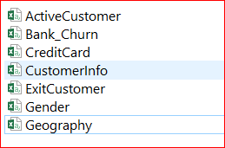
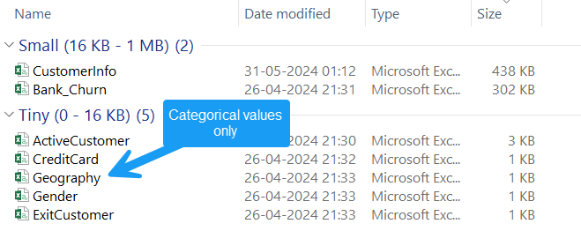
Objective Questions (Cont..)
How many different tables are given in the dataset, out of these tables which table only consist of categorical variables?
There are 7 different tables given to us in the dataset which are as bellows
Total Tables :
Out of these 7 tables , 5 table only consists of categorical variables which are

Slide 32
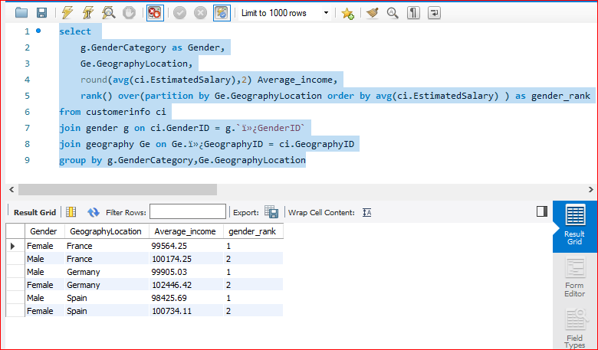
Objective Questions (Cont..)
Using SQL, write a query to find out the gender wise average income of male and female in each geography id. Also rank the gender according to the average value. (SQL)
select
g.GenderCategory as Gender,
Ge.GeographyLocation,
round(avg(ci.EstimatedSalary),2) Average_income,
rank() over(partition by Ge.GeographyLocation
order by avg(ci.EstimatedSalary) ) as gender_rank
from customerinfo ci
join gender g on ci.GenderID = g.`ï»¿GenderID`
join geography Ge on Ge.ï»¿GeographyID = ci.GeographyID
group by g.GenderCategory,Ge.GeographyLocation

Slide 33
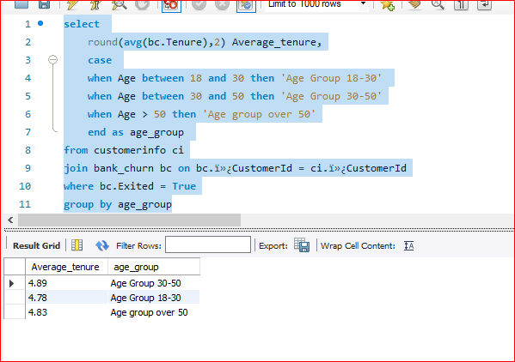
Objective Questions (Cont..)
Using SQL, write a query to find out the average tenure of the people who have exited in each age bracket (18-30, 30-50, 50+).
select
round(avg(bc.Tenure),2) Average_tenure,
case
when Age between 18 and 30 then 'Age Group 18-30'
when Age between 30 and 50 then 'Age Group 30-50'
when Age > 50 then 'Age group over 50'
end as age_group
from customerinfo ci
join bank_churn bc on bc.ï»¿CustomerId = ci.ï»¿CustomerId
where bc.Exited = True
group by age_group

Slide 34
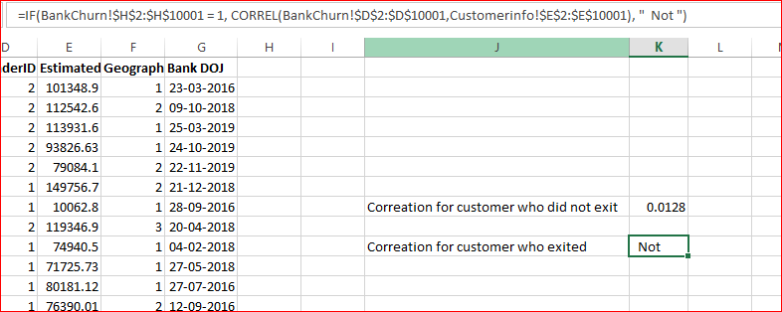
Objective Questions (Cont..)
Is there any direct correlation between salary and balance of the customers? And is it different for people who have exited or not?
Using excel:
The correlation coefficient for the customers who remained with the bank (not exited) is 0.0128

Slide 35
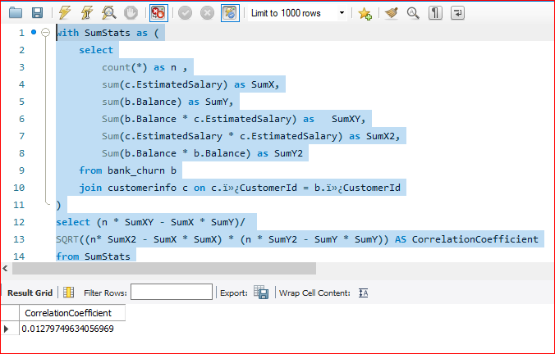
Objective Questions (Cont.)
Coefficient between Salary and Balance: 0.01279749634056969
It suggests that there is almost no linear relationship between these two variables.

Slide 36
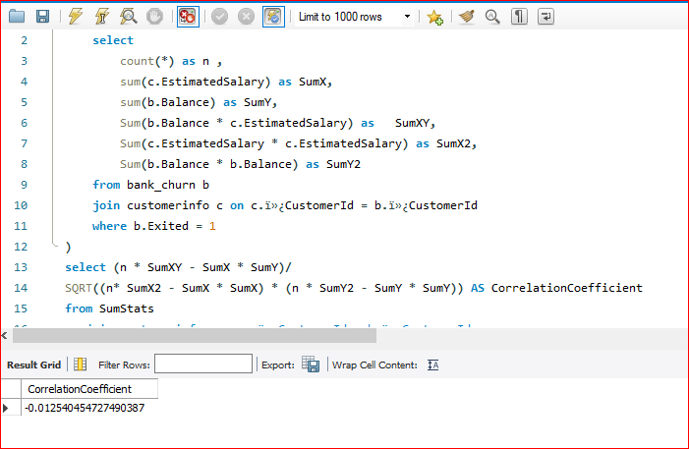
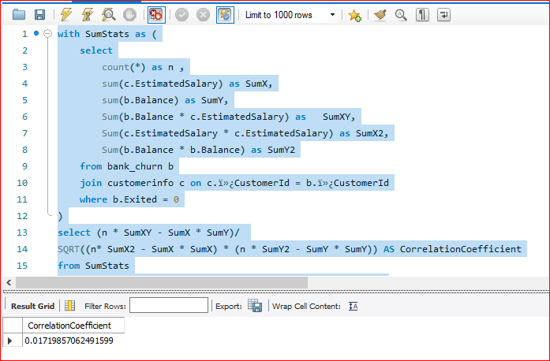
Objective Questions (Cont.)
Correlation Coefficient :
For Exited Customers : 0.01719857062491599
For Retained Customers : -0.012540454727490387

Slide 37
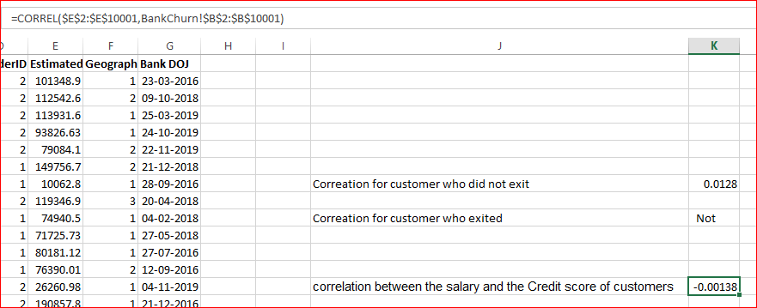
Objective Questions (Cont..)
Is there any correlation between salary and Credit score of customers?
A correlation coefficient of -0.00138 indicates a very weak negative correlation between salary and credit score. This means that there is almost no linear relationship between the two variables.
The negative sign indicates a slight tendency for credit score to decrease as salary increases, but this relationship is extremely weak.

Slide 38
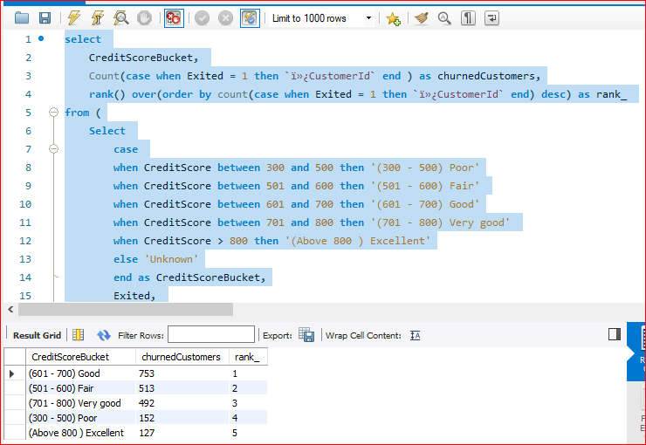
Objective Questions (Cont..)
Rank each bucket of credit score as per the number of customers who have churned the bank.
select
CreditScoreBucket,
Count(case when Exited = 1 then `ï»¿CustomerId` end ) as churnedCustomers,
rank() over(order by count(case when Exited = 1 then `ï»¿CustomerId` end) desc) as rank_
from (
Select
case
when CreditScore between 300 and 500 then '(300 - 500) Poor'
when CreditScore between 501 and 600 then '(501 - 600) Fair'
when CreditScore between 601 and 700 then '(601 - 700) Good'
when CreditScore between 701 and 800 then '(701 - 800) Very good'
when CreditScore > 800 then '(Above 800 ) Excellent'
else 'Unknown'
end as CreditScoreBucket,
Exited,
`ï»¿CustomerId`
from bank_churn )as subquery
group by CreditScoreBucket

Slide 39
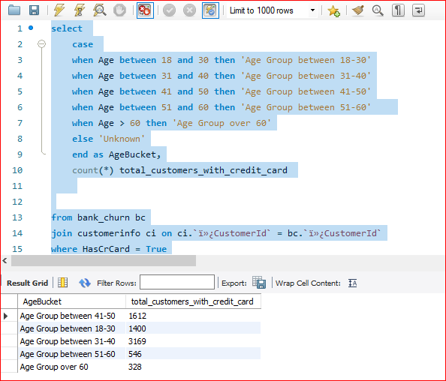
Objective Questions (Cont..)
According to the age buckets find the number of customers who have a credit card. Also retrieve those buckets who have lesser than average number of credit cards per bucket.
Age buckets to find the number of customers who have a credit card:
select
case
when Age between 18 and 30 then 'Age Group between 18-30'
when Age between 31 and 40 then 'Age Group between 31-40'
when Age between 41 and 50 then 'Age Group between 41-50'
when Age between 51 and 60 then 'Age Group between 51-60'
when Age > 60 then 'Age Group over 60'
else 'Unknown'
end as AgeBucket,
count(*) total_customers_with_credit_card
from bank_churn bc
join customerinfo ci on ci.`ï»¿CustomerId` = bc.`ï»¿CustomerId`
where HasCrCard = True
group by AgeBucket

Slide 40
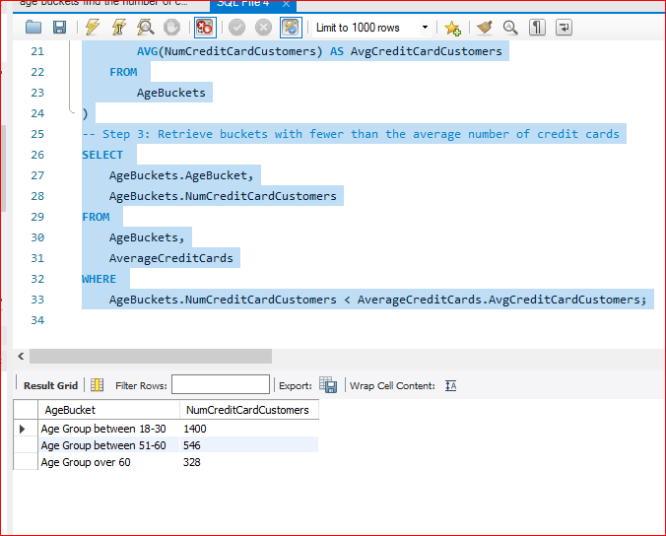
Objective Questions (Cont..)
To retrieve those buckets that have lesser than average number of credit cards per bucket.
As the SQL query was quite long ,we have put it in the objective.docx file .

Slide 41
Objective Questions (Cont..)
Rank the Locations as per the number of people who have churned the bank and average balance of the learners.
select
GeographyLocation,
ChurnedCustomers,
average_Balance,
rank() over(order by ChurnedCustomers desc) churnRank,
rank() over(order by average_Balance desc ) BalanceRank
from (select
g.GeographyLocation GeographyLocation,
count(case when bc.Exited = 1 then bc.`ï»¿CustomerId` end) as ChurnedCustomers ,
avg(bc.Balance) average_Balance
from customerinfo ci
join geography g on g.ï»¿GeographyID = ci.GeographyID
join bank_churn bc on bc.`ï»¿CustomerId` = ci.`ï»¿CustomerId`
group by g.GeographyLocation
) as location
order by churnRank, BalanceRank

Slide 42
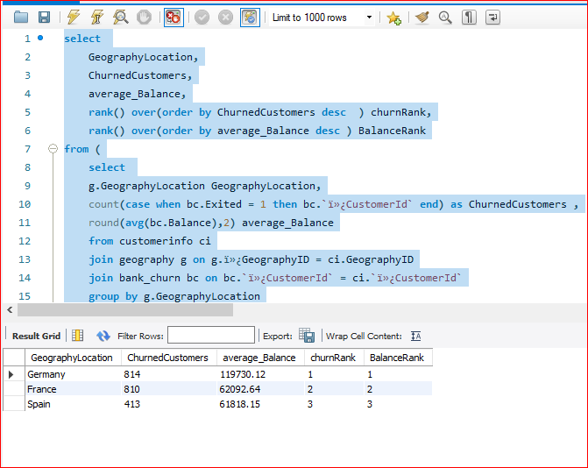
Objective Questions (Cont..)

Slide 43
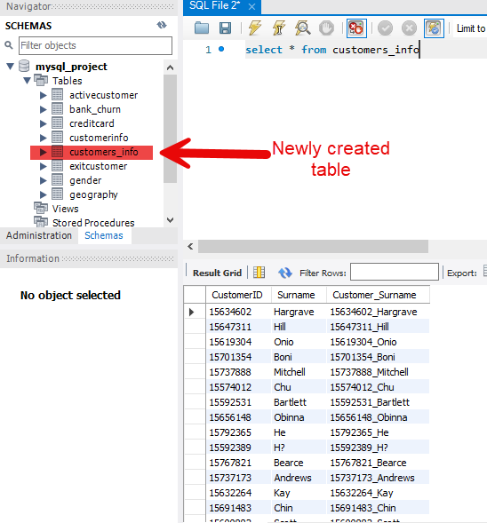
Objective Questions (Cont..)
As we can see that the “CustomerInfo” table has the CustomerID and Surname, now if we have to join it with a table where the primary key is also a combination of CustomerID and Surname, come up with a column where the format is “CustomerID_Surname”.
Approach : Initially we have created a new table with these three below fields
create table customers_info (
CustomerID int ,
Surname varchar(50),
Customer_Surname varchar(150)
);
Then we inserted the values from the existing CustomerInfo table
insert into customers_info
(CustomerId, Surname, Customer_Surname)
select `ï»¿CustomerId`,
Surname ,
concat(`ï»¿CustomerId` , "_",Surname)
from customerinfo;

Slide 44
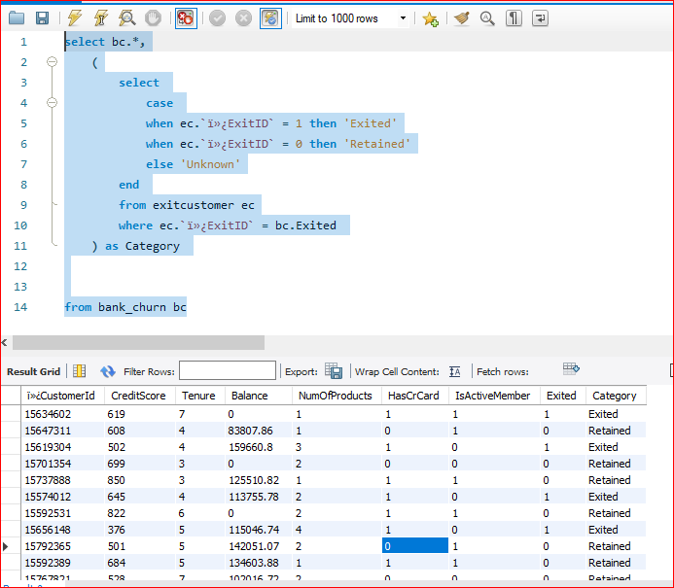
Objective Questions (Cont..)
Without using “Join”, can we get the “ExitCategory” from ExitCustomers table to Bank_Churn table? If yes do this using SQL.
Approach : We can use subquery to achieve it
select bc.*,
(
select
case
when ec.`ï»¿ExitID` = 1 then 'Exited'
when ec.`ï»¿ExitID` = 0 then 'Retained'
else 'Unknown'
end
from exitcustomer ec
where ec.`ï»¿ExitID` = bc.Exited
) as Category
from bank_churn bc

Slide 45
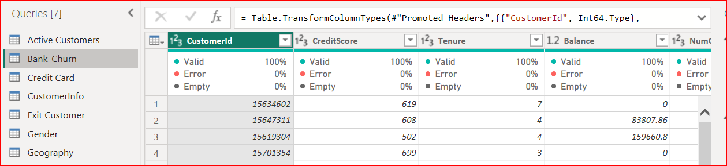
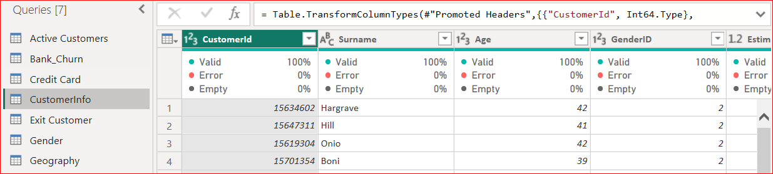
Objective Questions (Cont..)
Were there any missing values in the data, using which tool did you replace them and what are the ways to handle them?
Approach :
Initially we have loaded the data into Power BI and transform the data so that it can be opened in the Power Query Editor , in the view section we have added the Column quality option.
As we can see the quality is 100% in all the columns in both these tables “Bank Churn” and “CustomerInfo” . Rest all 5 tables are consists of only categorical variables.

Slide 46
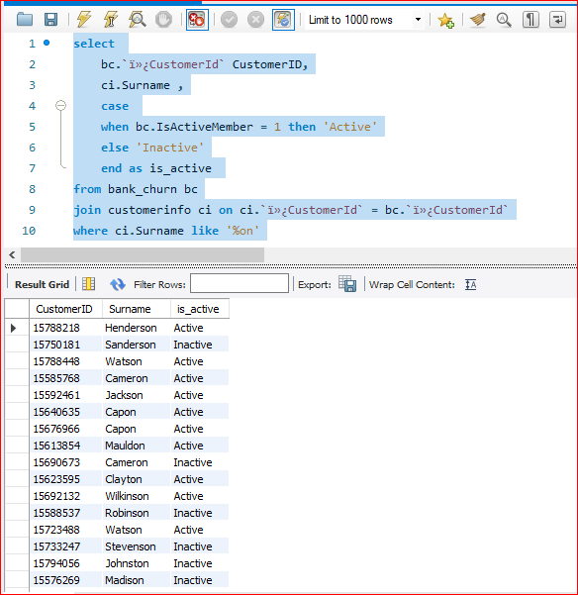
Objective Questions (Cont..)
Write the query to get the customer ids, their last name and whether they are active or not for the customers whose surname ends with “on”.
select
bc.`ï»¿CustomerId` CustomerID,
ci.Surname ,
case
when bc.IsActiveMember = 1 then 'Active'
else 'Inactive'
end as is_active
from bank_churn bc
join customerinfo ci on ci.`ï»¿CustomerId` = bc.`ï»¿CustomerId`
where ci.Surname like '%on'

Slide 47
Data Analysis and Visualizations (Subjective Questions):
Customer Behavior Analysis: What patterns can be observed in the spending habits of long-term customers compared to new customers, and what might these patterns suggest about customer loyalty?
Patterns in the spending habits of long-term customers compared to the new ones can provide valuable insights about customer loyalty.
Higher Average Spending:Long-term customers often have higher average spending compared to the new customers as the several factors kicks in and they are more familiar with the product/services offered.
Variety of Products : Long-term customers often have many products compared to the new customers as he are talking in regards to the banking/financial services . Long term customer probably have more services for eg. Forex card/credit card/ debit card/ loan disbursal etc compared to the new customer also Banks also have certain policies like you can avail this particular facility once after certain time period after joining /becoming a customer with the bank .

Slide 48
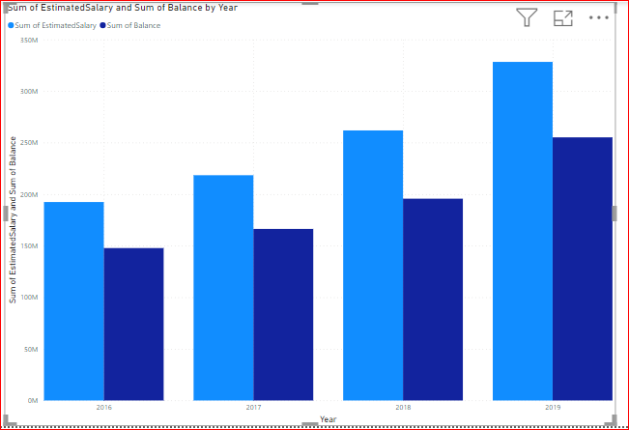
Data Analysis and Visualizations (Subjective Questions):
The below clustered column chart defines the sum of estimated salary and the sum of balance year-wise

Slide 49
Data Analysis and Visualizations (Subjective Questions):
Product Affinity Study: Which bank products or services are most commonly used together, and how might this influence cross-selling strategies?
A product affinity study can reveal which bank products or services are frequently used together by customers.
As higher the salary, the more customer is prone to spend, having credit card is also an added advantage. Number of products customer is having is also used commonly.
Influence on Cross-Selling Strategies :
Targeted Marketing: Armed with knowledge of product affinities, banks can create targeted marketing campaigns to promote related products to customers. For example, if customers who have a savings account are frequently found to also have a retirement savings plan, the bank can target savings account holders with promotions for retirement planning services.

Slide 50
Data Analysis and Visualizations (Subjective Questions):
Bundle Offerings: Banks can create bundled offerings or packages that combine complementary products based on affinity patterns. Offering discounts or incentives for bundled products encourages customers to purchase multiple products from the bank, increasing their overall engagement and loyalty.
Personalized Recommendations: Utilizing machine learning algorithms, banks can provide personalized recommendations to customers based on their usage patterns and product affinities.
Enhanced Customer Experience: By proactively offering relevant products and services based on customer preferences, banks can enhance the overall customer experience and build stronger relationships with their customers.

Slide 51
Data Analysis and Visualizations (Subjective Questions):
Geographic Market Trends: How do economic indicators in different geographic regions correlate with the number of active accounts and customer churn rates?
There is a complex relationship between economic indicators, number of active accounts, and customer churn rates across geographic markets. As per the provided data , we don’t have enough economic indicators such as unemployment rates ,GDP growth ,inflation rates.Here's a breakdown of some potential correlations:
Positive Correlation: GDP Growth and Active Accounts
Negative Correlation: GDP Growth and Churn Rate
Other factors to consider are Industry ,Customer Base,regional differences .

Slide 52
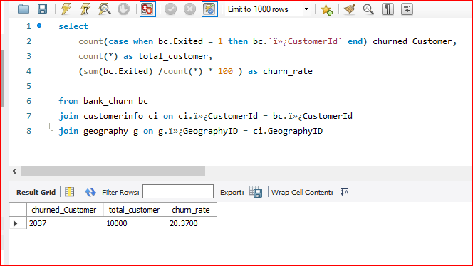
Data Analysis and Visualizations (Subjective Questions):
select
count(case when bc.Exited = 1 then bc.`ï»¿CustomerId` end) churned_Customer,
count(*) as total_customer,
(sum(bc.Exited) /count(*) * 100 ) as churn_rate
from bank_churn bc
join customerinfo ci on ci.ï»¿CustomerId = bc.ï»¿CustomerId
join geography g on g.ï»¿GeographyID = ci.GeographyID

Slide 53
Data Analysis and Visualizations (Subjective Questions):
Risk Management Assessment: Based on customer profiles, which demographic segments appear to pose the highest financial risk to the bank, and why?
select
g.GeographyLocation,
round(sum(b.Balance),2),
count(*) as total_customers,
round(sum(c.EstimatedSalary),2) sumofSalary,
count(case when Has_creditCard = true then b.`ï»¿CustomerId` end ) totalCustomerWithCrCard,
count(case when b.Exited = true then b.`ï»¿CustomerId` end) churnedCustomers,
(count(case when b.Exited = true then b.`ï»¿CustomerId` end) /count(*) * 100) churnRate_wrt_total_customer,
sum(b.NumOfProducts) as number_of_products
from customerinfo c
join geography g on g.ï»¿GeographyID = c.GeographyID
join bank_churn b on c.`ï»¿CustomerId` = b.`ï»¿CustomerId`
group by g.GeographyLocation

Slide 54
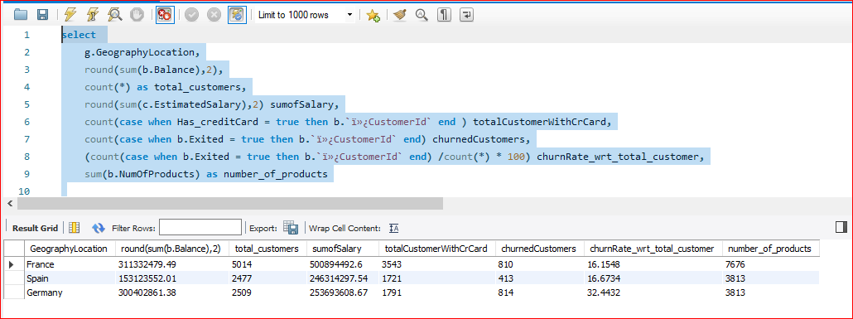
Data Analysis and Visualizations (Subjective Questions):
As we can see Germany is having the highest churn rate and it can probably pose the highest financial risk compared to other countries.
There are other factors as well for eg. Age Groups and retires

Slide 55
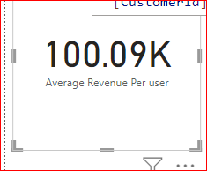
Data Analysis and Visualizations (Subjective Questions):
Customer Lifetime Value Forecast: How would you use the available data to model and predict the lifetime (tenure) value of different customer segments?
In order to forecast the availale data to model and predict the lifetime (tenure) , we have initially calculated these measures using Power BI.
Average Revenue Per user = DIVIDE(SUM(CustomerInfo[EstimatedSalary]),DISTINCTCOUNT(CustomerInfo[CustomerId]))

Slide 56
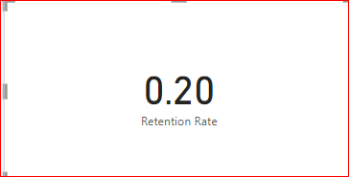
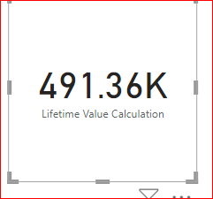
Data Analysis and Visualizations (Subjective Question) - (Cont…)
Retention Rate =
DIVIDE(COUNTROWS(FILTER(Bank_Churn, Bank_Churn[Exited or retained ] = "Yes")),COUNTROWS(Bank_Churn))
Lifetime Value (LTV) Calculation: Create a measure to calculate the average revenue per customer over a specific period
Lifetime Value Calculation = [Average Revenue Per user]/Bank_Churn[Retention Rate]

Slide 57
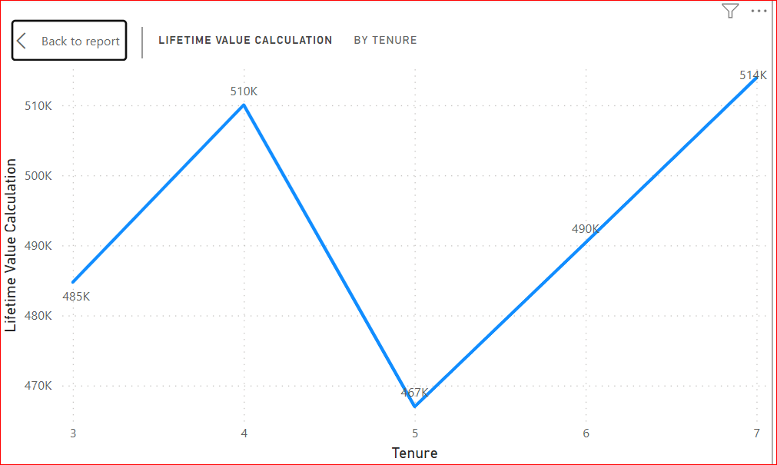
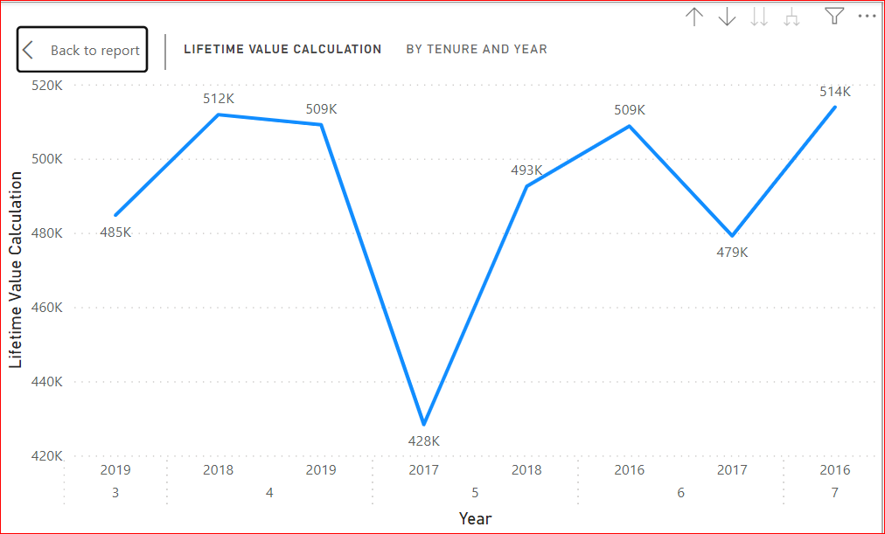
Data Analysis and Visualizations (Subjective Question) - (Cont…)

Slide 58
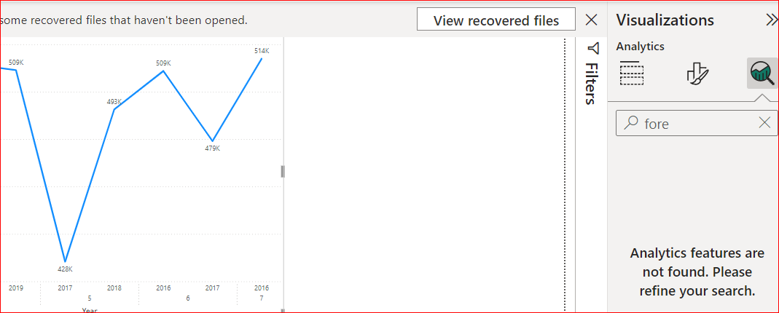
Data Analysis and Visualizations (Subjective Question) - (Cont…)
Since the option to forecast it isn’t available on the analytics tab, we haven’t forecasted it further.

Slide 59
Data Analysis and Visualizations (Subjective Question) - (Cont…)
Marketing Campaign Effectiveness: How could you assess the impact of marketing campaigns on customer retention and acquisition within the dataset? What extra information would you need to solve this?
Approach :
To assess the impact of marketing campaigns on customer retention and acquisition, you'll need to analyze how customers' behaviors and statuses (churned, retained, or acquired) are influenced by these campaigns. We have to define those key metrics .
Retention Rate = DIVIDE(
COUNTROWS(FILTER(Bank_Churn, Bank_Churn[Exited or retained ] = "Yes")),
COUNTROWS(Bank_Churn)
)

Slide 60
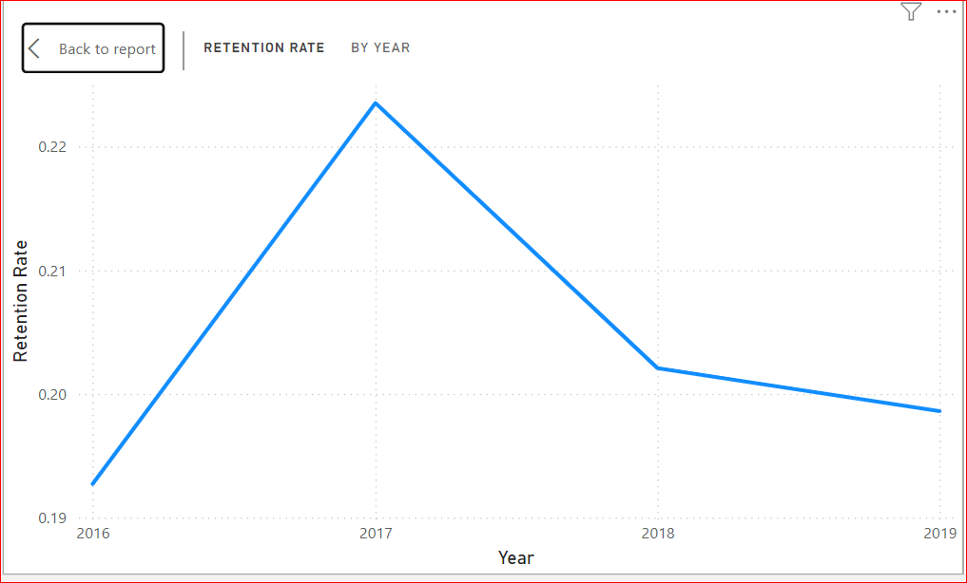
Data Analysis and Visualizations (Subjective Question) - (Cont…)
The extra information we are going to need is of Marketing campaigns in the data. If we have those information we can derive some comparative insights about before and after those marketing compaigns. Acquisition information , Churned information.

Slide 61
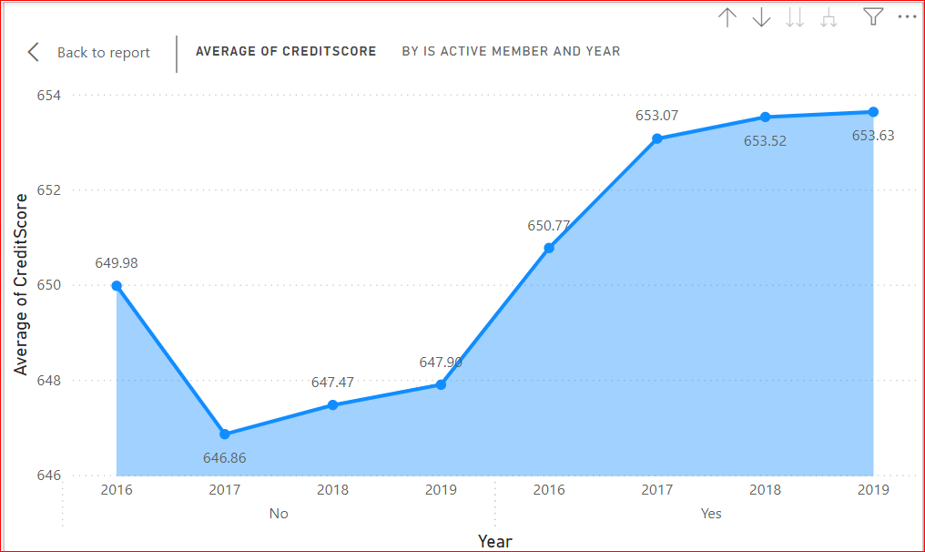
Data Analysis and Visualizations (Subjective Question) - (Cont…)
Customer Exit Reasons Exploration: Can you identify common characteristics or trends among customers who have exited that could explain their reasons for leaving?
To identify common characteristics or trends among customers who have exited, you can analyze various attributes of these customers and compare them with those who have stayed. This analysis will help uncover patterns that could explain why customers are leaving. Here’s how you can approach this:

Slide 62


Data Analysis and Visualizations (Subjective Question) - (Cont…)

Slide 63

Data Analysis and Visualizations (Subjective Question) - (Cont…)
As we seen from the above reports/visualizations that the customers have exited are usually having less number of resources comparing to the one who are retained .
They have less number of products , their balance , estimated salary , credit score all are less comparing to the one who are retained. It may be tough for them to to be the bank customer with less number of resources and there is some charges are levied on by the bank as well. It can be one of the reason for them to exit .

Slide 64


Data Analysis and Visualizations (Subjective Question) - (Cont…)
Are 'Tenure', 'NumOfProducts', 'IsActiveMember', and 'EstimatedSalary' important for predicting if a customer will leave the bank?

Slide 65
Data Analysis and Visualizations (Subjective Question) - (Cont…)
Yes, all of the factors mentioned (Tenure, NumOfProducts, IsActiveMember, and EstimatedSalary) are likely important for predicting if a customer will leave the bank (customer churn).
Tenure: Customers with a longer tenure at the bank have a greater chance of being familiar with the products and services offered, and may have developed a sense of loyalty. This makes them less likely to churn.
NumOfProducts: Customers who use a variety of the bank's products (accounts, credit cards, etc.) are more invested in the bank's ecosystem. This increased investment can make them less likely to switch to another bank.
IsActiveMember: Active members who regularly use the bank's services (online banking, transactions, etc.) are more likely to find value in the bank's offerings. This can make them less susceptible to churn compared to inactive members.
EstimatedSalary: Customers with a higher estimated salary might have a greater banking need and potentially a higher balance. This can make them more valuable to the bank and potentially influence efforts to retain them. However, it's important to note that a high salary might also indicate the ability to switch to a competitor offering premium services.

Slide 66

Data Analysis and Visualizations (Subjective Question) - (Cont…)

Slide 67

Data Analysis and Visualizations (Subjective Question) - (Cont…)
Utilize SQL queries to segment customers based on demographics and account details.
Approach: Initially we have to segment the Customers by Age and Country
As the code was quite long so we have put in the docx file.

Slide 68

Data Analysis and Visualizations (Subjective Question) - (Cont…)

Slide 69
Data Analysis and Visualizations (Subjective Question) - (Cont…)
How can we create a conditional formatting setup to visually highlight customers at risk of churn and to evaluate the impact of credit card rewards on customer retention?
Approach: Firstly we have to calculate the churn risk , we can deduce from the data that if any customer is having a tenure of less than two years and he is having only one product and also is not an active member , he’s likely to be leaving the bank Therefore it’s safe to say that the churn risk here is high.
If he is having a tenure of less than two years and he is having only one product but an active member ,the churn risk is medium and in other cases it’s low.
This is what we have done from the below SQL query:

Slide 70

Data Analysis and Visualizations (Subjective Question) - (Cont…)
select
* ,
case when Tenure <=3 and IsActiveMember = 0 and NumOfProducts = 1 then "High"
when Tenure < =3 and NumOfProducts = 1 then "Medium"
else "Low"
end as ChurnRisk
from bank_churn

Slide 71
Data Analysis and Visualizations (Subjective Question) - (Cont…)
We got the table now we have exported it and will load the same on the power BI .
We can do it in powerBI as well but there seems to be some issue so I’ve exported it from SQL .
Then we have calculated the Retention Rate with or without credit cards using DAX function, but in order to calculate the rate , we need to calculate the retention with or without rewards and the total with or without rewards.
Then only we can calculate the rate ., we need to calculate the retention with or without rewards and the total with or without rewards.
Then only we can calculate the rate .

Slide 72
Data Analysis and Visualizations (Subjective Question) - (Cont…)
Total With Rewards = CALCULATE(COUNTROWS('Bank_Churn'),Bank_Churn[Has Credit Card] = "Yes")
Total without Rewards = CALCULATE(COUNTROWS('Bank_Churn'),Bank_Churn[Has Credit Card] = "No")
Retention without rewards = CALCULATE(COUNTROWS(Bank_Churn),Bank_Churn[Has Credit Card] = "No" ,Bank_Churn[Exited or retained] = "Retained")
Retention with rewards =
CALCULATE( COUNTROWS('Bank_Churn'),Bank_Churn[Has Credit Card] = "Yes",Bank_Churn[Exited or retained] = "Exited")
Retention Rate without Rewards =
DIVIDE([Retention without rewards],[Total without Rewards])

Slide 73


Data Analysis and Visualizations (Subjective Question) - (Cont…)
We have created a table visual and selected the required fields in the table visual and in the visual setting of the table reported ,under section Cell Elements ,selected the series as Churn risk and defined the rules like
High risk will be in red color , low will be in somewhat green.

Slide 74

Data Analysis and Visualizations (Subjective Question) - (Cont…)

Slide 75
Data Analysis and Visualizations (Subjective Question) - (Cont…)
What is the current churn rate per year and overall as well in the bank. Can you suggest some insights to the bank about which kind of customers are more likely to churn and what are the different strategies that can be used to decrease the churn rate.
We have done it in PowerBI using DAX functions
ChurnDate =
VAR JoinDate =
CALCULATE(
MAX(CustomerInfo[Bank DOJ]),
FILTER(CustomerInfo, CustomerInfo[CustomerId] = Bank_Churn[CustomerId])
)
RETURN DATE(YEAR(JoinDate) + Bank_Churn[Tenure], MONTH(JoinDate), DAY(JoinDate))

Slide 76

Data Analysis and Visualizations (Subjective Question) - (Cont…)
Annual Churn Rate = DIVIDE(COUNTROWS(Bank_Churn),CALCULATE(COUNTROWS(Bank_Churn),ALL(Bank_Churn[ChurnDate]))* 100)

Slide 77


Data Analysis and Visualizations (Subjective Question) - (Cont…)

Slide 78

Data Analysis and Visualizations (Subjective Question) - (Cont…)
Create a dashboard incorporating all the KPIs and visualization related metrics. Use a slicer in order to assist in selection in the dashboard.

Slide 79

Data Analysis and Visualizations (Subjective Question) - (Cont…)

Slide 80

Data Analysis and Visualizations (Subjective Question) - (Cont…)

Slide 81
Data Analysis and Visualizations (Subjective Question) - (Cont…)
How would you approach this problem, if the objective and subjective questions weren't given?
Approaching a problem without predefined objective and subjective questions can be tricky and complex as it involves a structured and strategic method to identify key areas of focus.
Certainly, We won’t be able to pull this much information if these pre-defined objective and subjective questions were not given as it have a wide range of question from Analytical approach to hypothesis . But even if the question weren’t given ,we can certainly extract information such as
Average balance across different geographical regions and how it’s expanding over the time,
Distribution of wealth among male and female
Customers with highest estimated salary/balance on gender basic and ranking them in descending order
How many active customers are there
Churn rate and new customers over the year and so on.
And so on…

Slide 82

Data Analysis and Visualizations (Subjective Question) - (Cont…)
In the “Bank_Churn” table how can you modify the name of “HasCrCard” column to “Has_creditcard”?
alter table bank_churn
rename column HasCrCard to Has_creditCard;
select * from bank_churn;

Slide 83

Dashboard:

Slide 84

Dashboard:

Slide 85

Dashboard:

Slide 86
Conclusion:
Our comprehensive analysis provided valuable insights into customer behavior, revealing key factors influencing churn and retention with visualizations and insights . By leveraging these insights, we can:
Enhance Engagement: Focus on activity status and product usage to improve retention.
Targeted Marketing: Develop data-driven marketing strategies to engage high-risk segments.
Product Development: Create products and services that cater to the needs of mid-career professionals and high-balance customers.

Slide 87


